Slide 1
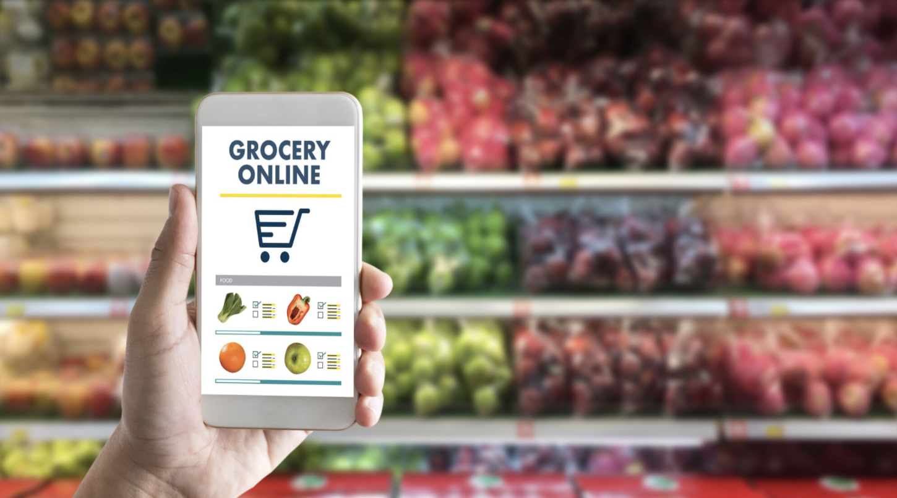
Grocery management system

Slide 2
Group Member's
Srikanth Guduri (700741216)
Vineeth Reddy Anugu (700741265)
Sindhu Burra (700734353)
Sirisha Reddiroutu (700741117)

Slide 3
INTRODUCTION
This project is aimed at developing a web-based application that depicts online shopping of grocery products.
It integrates the benefits of ordering products with the convenience of an online excitement and going with the technology, minus the commuting hazards and expenses.

Slide 4
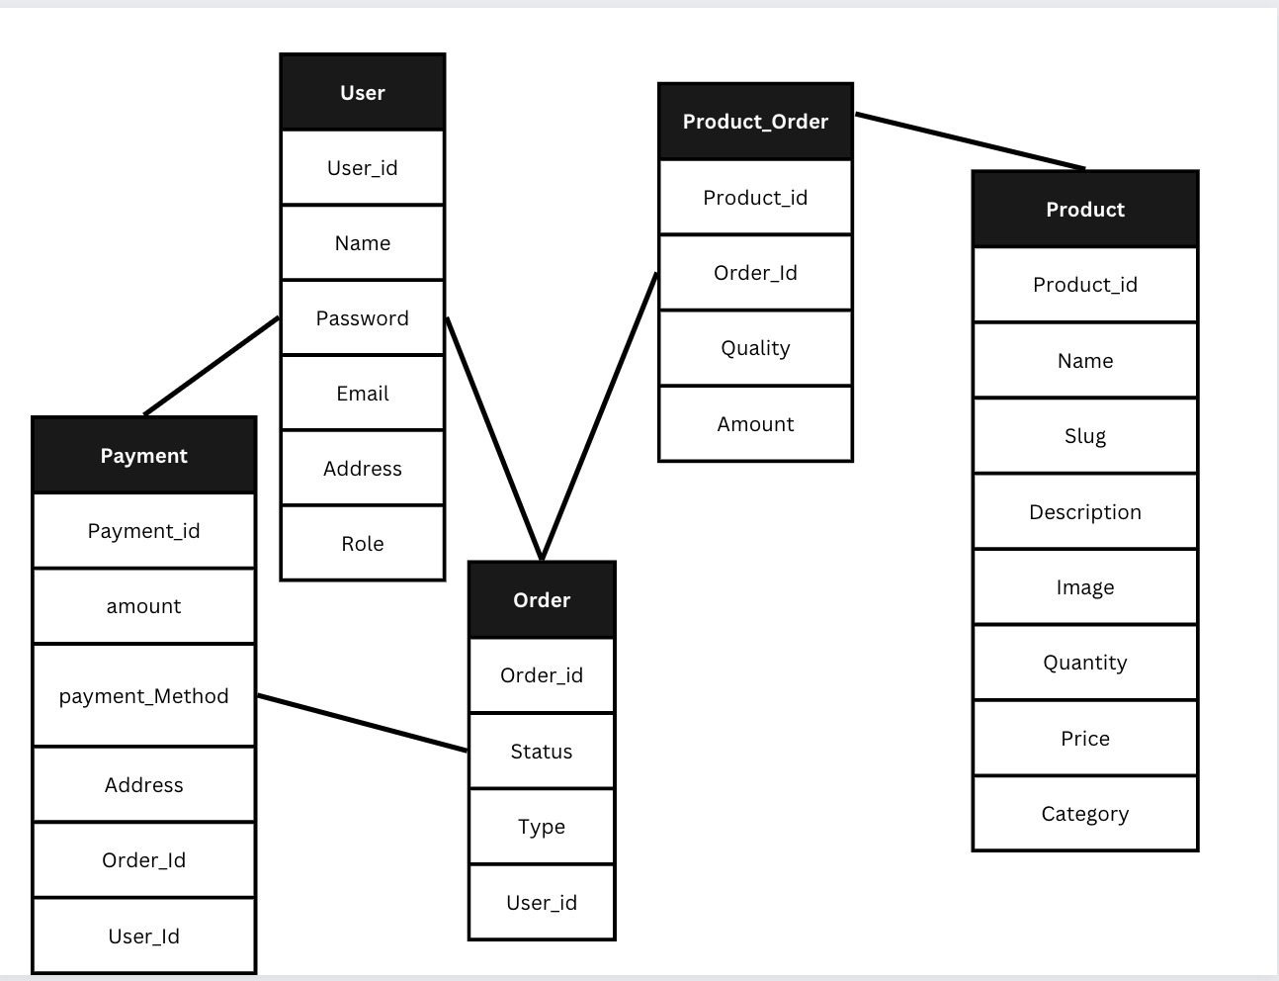
DATABASE MODEL

Slide 5
TECHNOLOGIES USED
NODE JS (Server-Side Language)
MongoDB Atlas (Backend- Database)

Slide 6
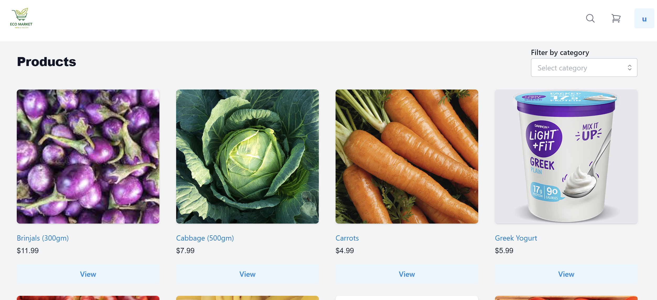
Functionality – Homepage

Slide 7
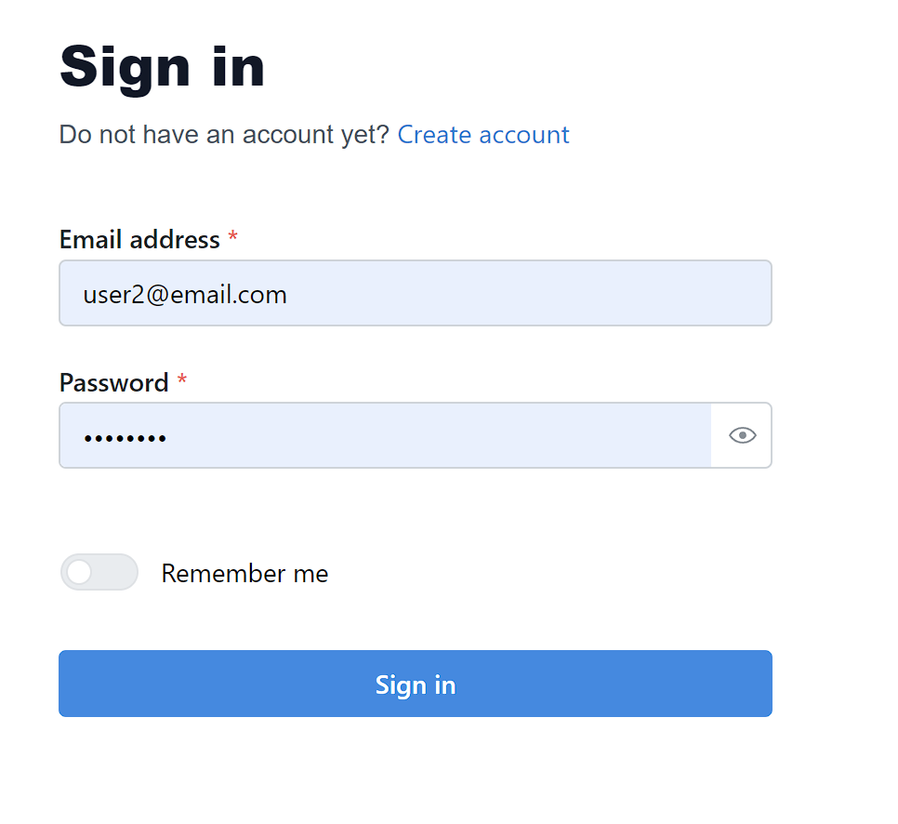
Functionality- login or Register

Slide 8
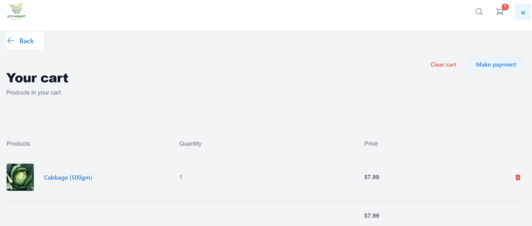
Manage Order(Cart)

Slide 9
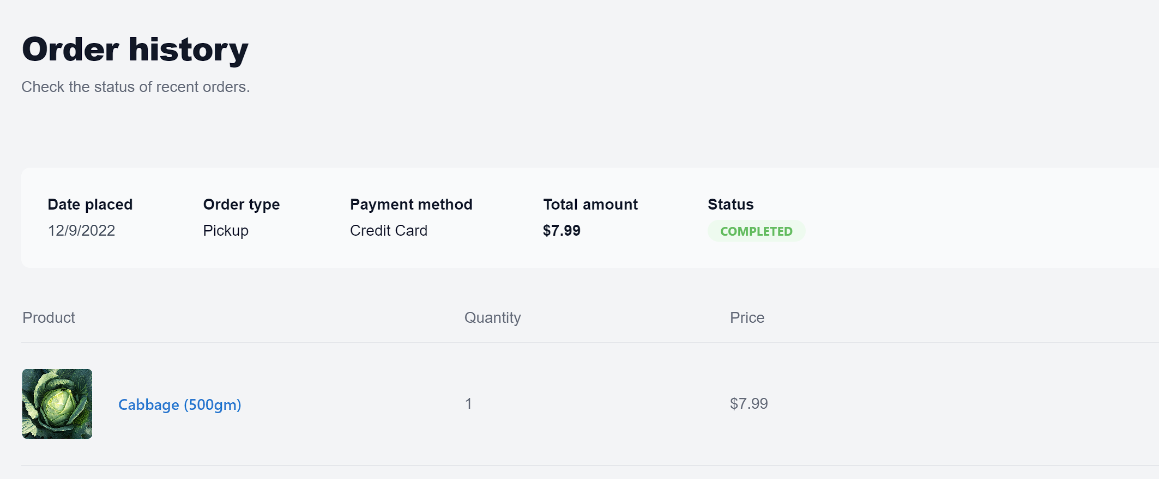
Order history

Slide 10
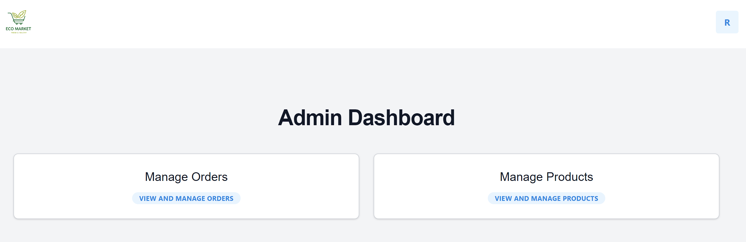
Admin Dashboard

Slide 11
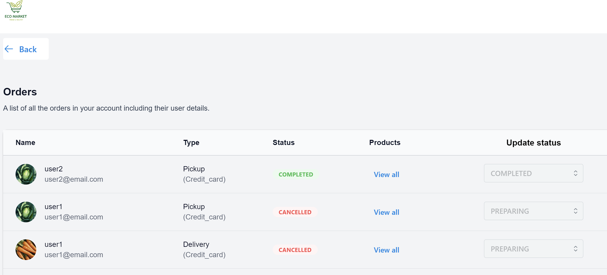
Manage Orders(ADMIN)

Slide 12
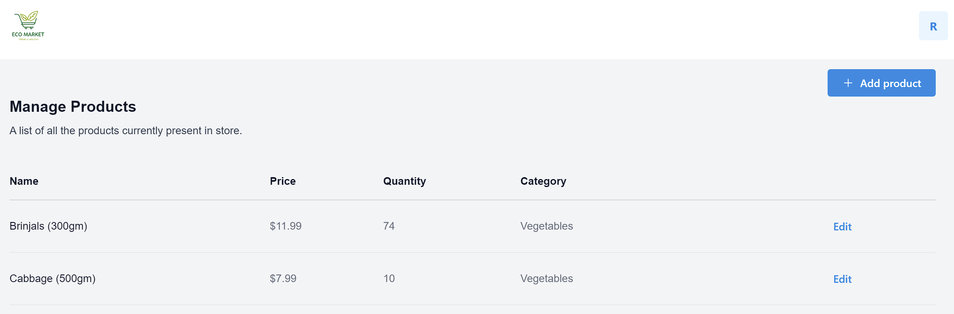
Manage Products(admi)

Slide 13
Conclusion
Grocery store management is a very important tool for every store to keep a record of all their
data and use this information for business purposes. Most importantly, it is used to maintain
store inventory records and customer details. Online grocery shopping is a great way to get the
food your customers need without having to go to the grocery store and order it at any time of
the day. No need to check store opening hours or fret as they reorder shelves. Online grocery
services have an easy-to-navigate app that customers can use on the go. With just a few
buttons, they can order groceries, pay the total amount online using card or can pay cash when
the groceries are delivered to their doorstep by the employees. If the customers don’t like the
groceries or the food is not fresh, then they can return the products back to the store.

